Slide 1

CS 205 Project - M3
Parallelizing Crop Phenology
reports via NDVI datasets
Team 18:
Elaine Swanson, Alex Johnson,
Saketh Mynampati, Alyssa Ross

Slide 2
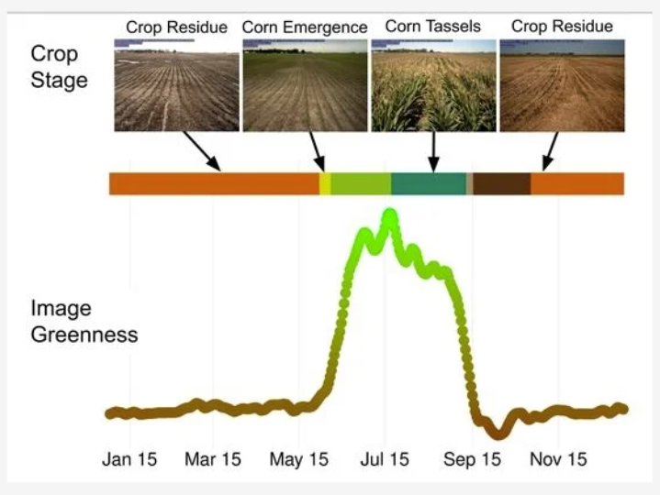

Problem: Crop phenology using NDVI data
What is crop phenology (crop stages)?
How do we get crop phenology using the Normalized Difference Vegetation Index (NDVI = greenness)?
How do we do this efficiently over ~380,000 km² of land and over two decades? So far that is ~ 4.2 billion potential reports
(NDVI)
Source: https://www.mdpi.com/2072-4292/14/2/286
Notes:
Alyssa
Crop phenology refers to the timing of planting, emergence, maturity, and harvest on a specific crop land. The point in time when these events occur in a crops’ lifespan affects the yield and long-term fertility of the land it is grown upon.
Explain top part of graph
Refer to bottom part of graph
Crop stages can be tracked by the amount of “greenness” in a satellite image or the normalized difference vegetation index. It is calculated by taking the RED and the NEAR INFRARED spectral reflectances of an image and performing this equation on every pixel.
So why is this important? With current shifts in the climate, farmers are having to adjust when they plant and harvest, and gain a new understanding of the overall growth throughout the year. Having a way to analyze the past trends of crop phenology, over several decades and over a large geographic area, is vital to understand potential changes. How do we optimally use computational resources to process geo-spatial image data?

Slide 3
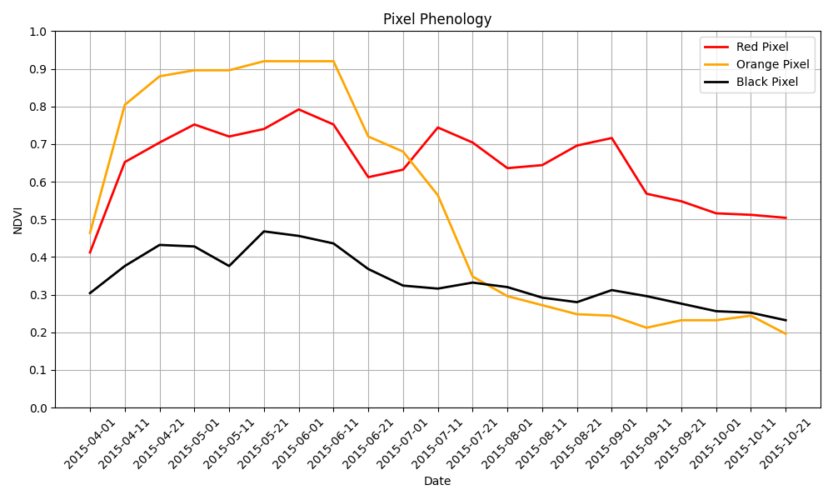
Data and Model:
NDVI of Baker Valley, OR in 2015
Dataset name: CGLS Collection NDVI Version 2
Obtained by the Sentinel-3 Satellite (European Space Agency) data products via the openEO API and VITO Backend
Temporal information: Three products per month dated day 1, day 11 and day 21 of each month
Spatial Information: Global coverage, but just pulling and focusing on the North West USA, 300 meter resolution
Forms hypercube I(x,y,t,⍵)
Limitations: Can’t differentiate between intended agricultural crops and natural vegetation (ex. forests, marshlands)
Need to overlap with actual crop parcel data. Crop delineation dataset obtained via U-Net
Notes:
Saketh
THE DATA
Copernicus Dataset from the European Union, which has NDVI data over different coordinates and time, from the Sentinel-3 satellite. We access these data via calls to OpenEO API via the VITO Backend, which can be run on any cloud computing platform.
The data exists as 3 snapshots of NDVI over an area per month, with data for the entire globe. We will be focusing on the North West US, with a 300 meter data resolution. The data is dense across these four variables, forming a hypercube that lends itself to splitting and parallel processing.
Explain Graph 1 and 2!
Red:
Orange:
Black:
One limitation, whose solution also has the capability to be parallelized, is that we can’t differentiate between intended, domestic crops and natural vegetation.
Need to overlap with actual crop parcel data to isolate crops.
Crop delineation done by segmenting U-Net
Opportunity to parallelize model.
THE MODELS
Read the slide and explain the graphs.
There are limitations of the “greenness” measure and the inability of NDVI to differentiate between crop land and forests (show example in bottom left of the GIF images. That is all forest.
There is also a layer of difficulty with the spatial resolution of 300 meters, there might be one or two crops within one pixel. Or there might be no crops within a pixel.
So we need an additional dataset that detects the crop parcels within the pixel. This is an edge detection, or a crop delineation, image we have to build using a NN U-Net structure whenever we get an NDVI image form openEO.

Slide 4
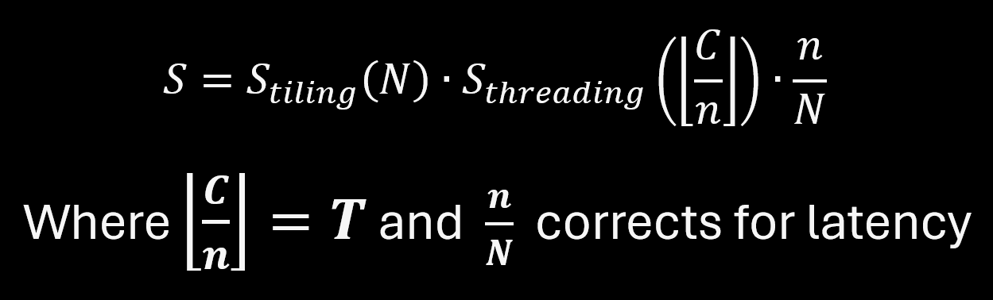
Need for Shared Parallelization:
Create NDVI dataset, create parcel dataset, create crop phenology reports
Crop Parcels → Pixels → Tiles
A tiling scheme with many small tiles increases overhead and can introduce extra latency.
multi-threading and tiling must be combined
Goal: maximize a version of Amdahl’s Speedup Law:
For P = parallelization, N = number of tiles, n = subset of tiles due to lack of cores/memory, T = number of threads, C = number of cores
Notes:
Alex
When we start to introduce parcels, the importance of breaking these tasks (creating NDVI dataset, creating parcel dataset, creating crop phenology reports) up means we have to be mindful of how we disperse the work. A phenology report on one thread per parcel is too fine, one thread per pixel is also too fine. So we must combine several parcels and pixels into a tiling scheme.
Read bullet point 2 and 3
Use parallelization (multi-threading and tiling) to optimize resource usage
Trade off between induced serial processing from tiling (reading data) and increased parallelization of image processing
Optimal strategy depends on available resources
Paper we are replicating found max speedup for 36 overlapping tiles, 1 tile = 600 x 600 pixels, and utilizing 30 threads

Slide 5

Draft Plan:
Formulate our spatial aggregation workflow using the openEO VITO backend
Using main package:
largely depends of the JIPlib library, which is implemented in C++ and contains three main classes: Jim, JimList and VectorOgr. Other dependency in C++ is miallib.
Jim is the main class to represent raster data objects
Have to almost rebuild this open source package due to backend restrictions by Italian government 🤌
Then use Python interface via Simplified Wrapper and Interface Generator (SWIG)
pyjeo supports multi-threading using OpenMP API and setting CPU affinity
Notes:
Elaine:
Read the slide
Running all threads on different physical cores results in true simultaneous execution and improves parallelism.

